Slide 1
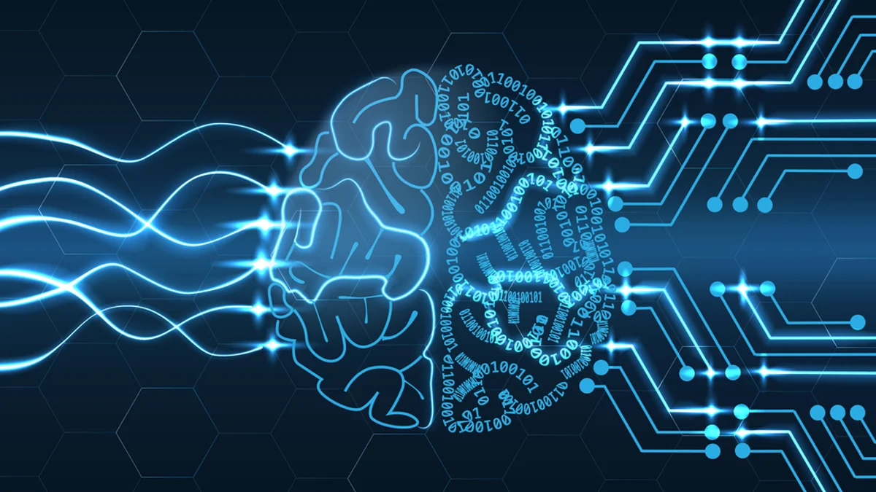
SIGN LANGUAGE INTERPRETER USING DEEP LEARNING
PRESENTED BY:
1805065 - AAMIR FAROOQ
1805095 - LISHARA V
1805097 - MADHUVARSHINI R
1805100 - MUHYMIN FAROOQ

Slide 2
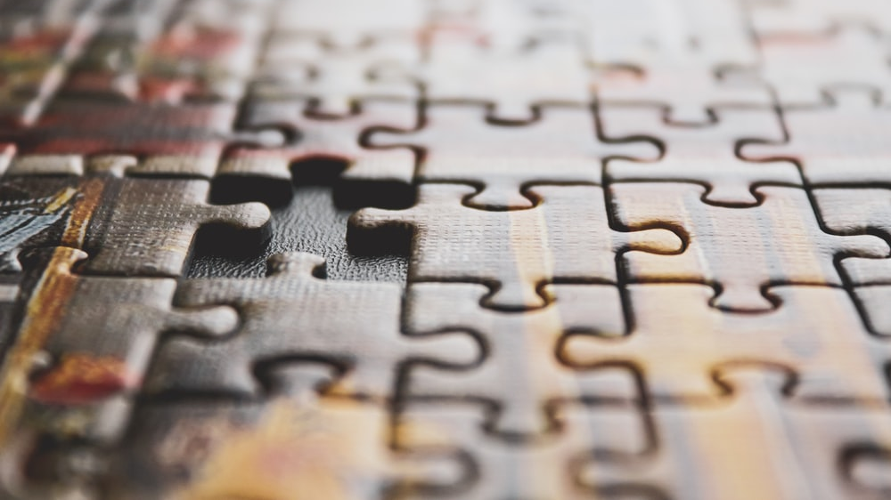
PROBLEM STATEMENT
Development of a personalized and real-time sign language interpreter and text interpreter.

Slide 3

ABSTRACT
Sign language plays an important part in the hearing/speech impaired person's life as it is the prime medium of communication for them. However, not everyone understands the sign language hence, it becomes difficult for the disabled to communicate in day-to-day life. The sign language constitutes of various hand gestures which can represent various words and expressions. In this project, the aim is to build a reliable communication interpretation program for interpreting sign language and converting it to a readable output. The task can be accomplished using image processing and deep learning. Our proposed project can find its applicability in the day to day lives of millions of people and allow for better communication.

Slide 4
LITERATURE SURVEY
PAPER 1: MODELS FOR HAND GESTURE RECOGNITION:
Sign languages conveyed using hand gestures is used by deaf and dumb people as it provides a way of communication with the world around them. In this paper, the aim is to interpret sign language hand gestures from a live stream captured by the webcam using CNN (CONVOLUTIONAL NEURAL NETWORK) which is a type of deep neural network and is most commonly used for visual imagery.
DOMAIN | DATASET | ALGORITHM | SOFTWARE/ HARDWARE | LIMITATION/ SCOPE
NEURAL NETWORKS | KAGGLE – MNIST DATASET | ADAM OPTIMIZER, INCEPTION V3 | WEB CAMERA | The model doesn't work well for larger datasets with more letters.

Slide 5
LITERATURE SURVEY
PAPER 2: LARGE SCALE SIGN LANGUAGE INTERPRETATION:
Sign language is an integral part of deaf culture. Different from hand gestures, sign language builds a communication system composed of hand pattern movement, facial expression, and body pose. In this paper the authors employed the world’s largest continuous sign language dataset, a collection of 50,000 videos, and then propose several deep learning features and frameworks for advanced sign language recognition.
DOMAIN | DATASET | ALGORITHM | SOFTWARE/ HARDWARE | LIMITATION/ SCOPE
DEEP LEARNING | CHINESE SIGN LANGUAGE DATASET | S2VT, TWO LAYER LSTM | DATA GLOVE, MYOELECTRIC SENSORS, CAMERAS, DEPTH SENSORS, RGB SENSORS | The currently employed methods are able to overfit training splits.

Slide 6
LITERATURE SURVEY
PAPER 3: DEVELOPMENT OF A SIGN LANGUAGE FOR TOTAL PARALYSIS AND INTERPRETATION USING DEEP LEARNING:
The complete loss of strength in an affected limb or muscle group is defined as paralysis. This paper concentrates are:
1) Introducing a new sign language for people with total paralysis.
2) This new language is not dependent on electronic technology as it can be interpreted by anyone with assisting chart.
3) Building a CNN model to detect the pupil position and interpret the sign language.
DOMAIN | DATASET | ALGORITHM | SOFTWARE/ HARDWARE | LIMITATION/ SCOPE
NEURAL NETWORKS | OWN DATASET COMPRISING 14,354 IMAGES | CNN | WEB CAMERA | A sign language with proper grammar was developed.

Slide 7
LITERATURE SURVEY
PAPER 4: INDIAN SIGN LANGUAGE INTERPRETER USING IMAGE PROCESSING AND MACHINE LEARNING:
This paper, aims at building a reliable communication interpretation program for interpreting Indian sign language and converting it to a readable output. The task is accomplished using Image processing and Machine learning.
DOMAIN | DATASET | ALGORITHM | SOFTWARE/ HARDWARE | LIMITATION/ SCOPE
MACHINE LEARNING AND IMAGE PROCESSING | ISL | CNN, HSV | WEB CAMERA | This is portable via raspberry pi.

Slide 8
LITERATURE SURVEY
PAPER 5: SIGN LANGUAGE INTERPRETATION USING DEEP LEARNING:
In this project, a sign language recognition system has been developed for people who do not know sign language, to communicate easily with hearing-impaired people. This project focuses on interpreting American Sign Language and also provides a complete overview of deep learning-based methodologies for sign language recognition.
DOMAIN | DATASET | ALGORITHM | SOFTWARE/ HARDWARE | LIMITATION/ SCOPE
DEEP LEARNING AND NEURAL NETWORKS | AMERICAN SIGN LANGUAGE DATA SET | CNN | WEB CAMERA | The project is implemented without the help of gloves.

Slide 9
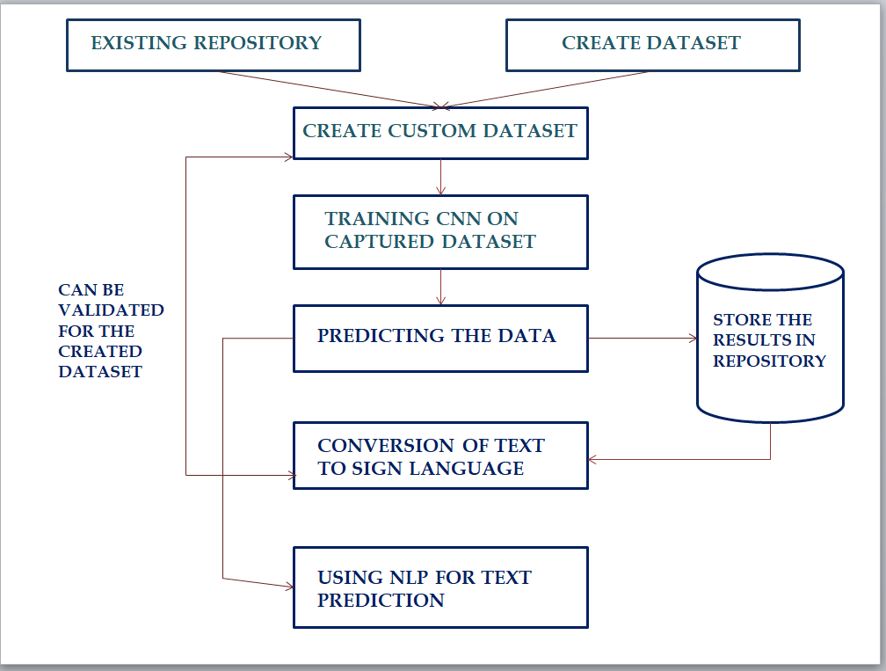
ARCHITECHTURAL DIAGRAM

Slide 10

SOFTWARE AND FRAMEWORKS
PYTHON
NUMPY
CV2
KERAS
TENSORFLOW

Slide 11

MODULE 1: CREATING DATASET
Creation of custom data set for every user
Generic dataset can be used too but preference is given to custom dataset
Live feed from the video cam and every frame that detects a hand in the ROI (region of interest) created will be saved in a directory

Slide 12
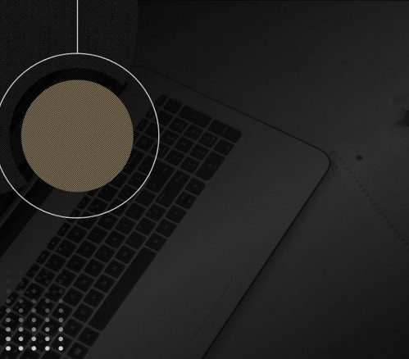
MODULE 2: TRAINING A CNN ON THE CAPTURED DATASET
A Convolutional Neural Network (ConvNet/CNN) is a Deep Learning algorithm which can take in an input image, assign importance (learnable weights and biases) to various aspects/objects in the image and be able to differentiate one from the other.
The Model is generated in this stage and is used in the 3rd Module

Slide 13
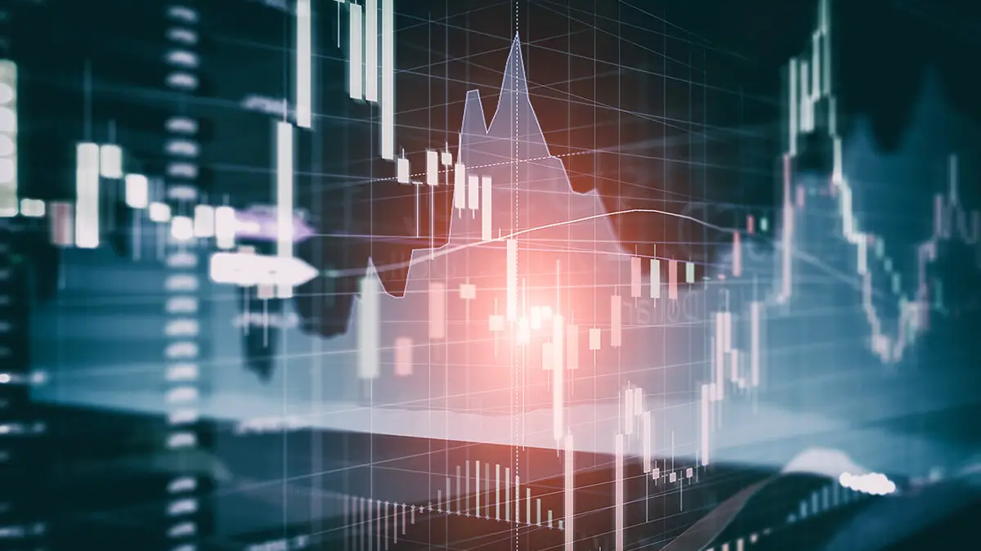
MODULE 3: PREDICTING THE DATA
A bounding box is created for detecting the ROI and the Accumulated Average is calculated as we did in creating the dataset. This is done for identifying any foreground object.
Load the previously saved model using keras.models.load_model and feed the threshold image of the ROI consisting of the hand as an input to the model for prediction.
Displays the Predictions in Real-time

Slide 14
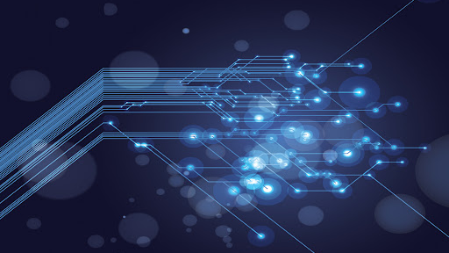
MODULE 4: CONVERSION OF TEXT TO SIGN LANGUAGE
This module converts the Text Input into Sign language
Uses the dataset provided to convert Words into signs

Slide 15
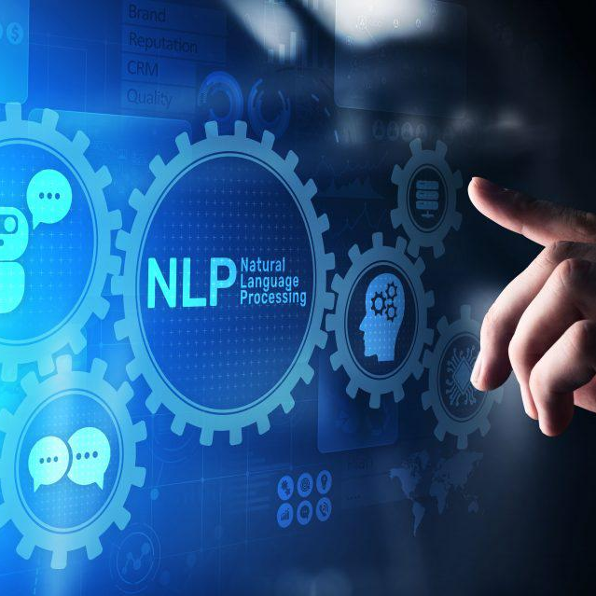
MODULE 5: USING NLP FOR TEXT/SIGN PREDICTION
In this Module, Natural Language Processing will be used to predict the statement/words
This Module will be personalized for each user

Slide 16
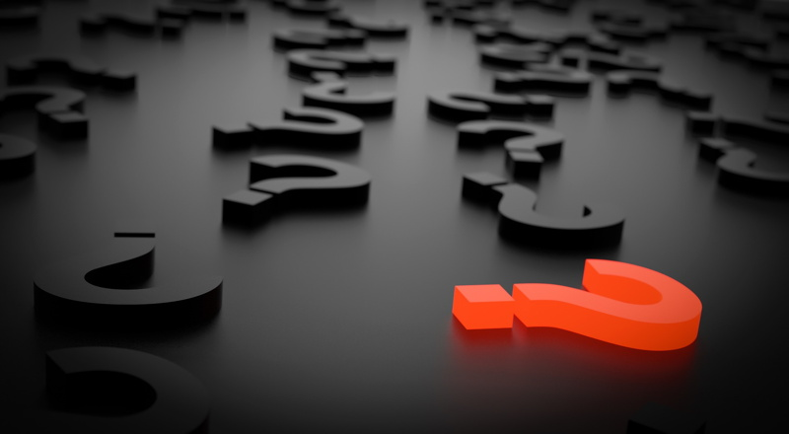
ANY QUERIES

Slide 17
